Slide 1

Classification of Firewall Log Files
Mentor:
Mr. Abhishek Verma
Group 1 members:
Ashita Goyal-181500144
Bharti Gautam-181500192
Naina Agarwal-181500408
Nandani Bansal-181500413
Department of Computer Engineering and Applications
GLA University, Mathura
Uttar Pradesh, India

Slide 2
Overview Of Presentation:
Introduction
Statement of the Problem
Motivation
Objective
Models
Dataset
Results
Scope for future works
References

Slide 3
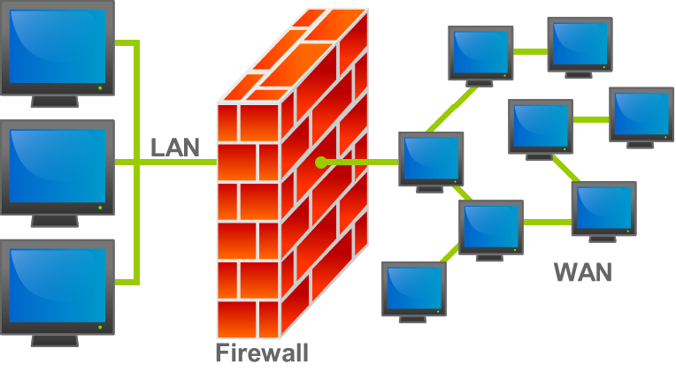
Introduction
A firewall monitors traffic into and out of the environment it was developed to protect.Firewall devices on a network can either allow or prevent traffic according to the policy. The system administrator sets up firewalls for each organization's needs.
Analyzes of security firewall records using machine learning approaches are available. In this study, we can use any classification model to analyzes firewall log files

Slide 4
Statement Of The Problem
In this model of classification of firewall log files, we are going to analyze the logs on the firewall devices and control the internet traffic according to these analysis results.

Slide 5
Motivation
Firewall is the most important element in computer networks which play an important role in network security. The configuration of firewalls is vital for communication networks to work properly and secure. Correct configuration of these systems make a significant contribution to the active and effective use of companies' communication technologies and other existing network devices.
Firewall log contains important information that reveals powerful insights into the security issues, without log analysis it is difficult to monitor traffic flow so it is very important to classify the log file into various categories to manage the traffic.

Slide 6
OBJECTIVE
Our Objective is to classify the various log files with multiclass support vector machine so that traffic on the network can be controlled. The action attribute in the dataset is used as class which can have following values : allow, deny, drop and reset both.

Slide 7
Dataset
Dataset for the given problem contains 65532 entries.
The attributes of the datasets are:
Source Port: Client Source Port
Destination Port: Client Destination Port
NAT Source Port: Network Address Translation Source port
NAT Destination Port: Network Address Translation Destination port
Elapsed Time (sec) : Time for flow
Bytes :Total Bytes

Slide 8
Dataset
Bytes Sent
Bytes Received
Packets : Total no of Packets
Pkts_sent: Packets sent
Pkts_received: Packets received
Action: Class (Allow, deny, drop, reset-both)
There are 4 classes in the action attribute used as a class. Descriptions of these classes are:
Allow: Allows the internet traffic
Deny: Blocks traffic and enforces the default Deny Action defined for the application that is being denied
Drop: Silently drops the traffic; for an application, it overrides the default deny action. A TCP reset is not sent to the host/application.
Reset-Both : Sends a TCP reset to both the client-side and server-side devices.

Slide 9
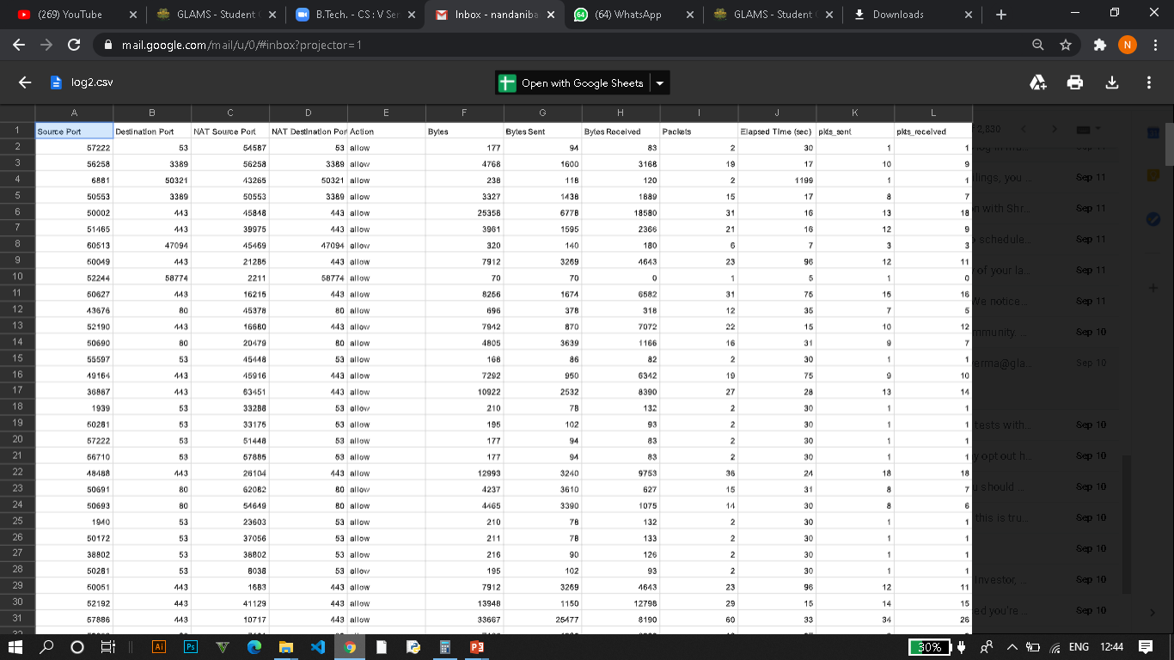
Dataset

Slide 10
Results
In order to measure the performance of the classifier, the comparison was made by finding the measurement values of sensitivity, recall and their harmonic mean F1 Score, by using different algorithms.
The best algorithm is used for the analysis of the model.
The analyses of the log records on the Firewall devices was done.

Slide 11
Scope For Future Works
There are some of the tasks that can be done in future work related to this project study-
The accuracy of the prepared system can be improved further.
The design of an intelligent system can be prepared that can decide on its own how to handle a lot more data with information to be extracted from the firewall logs.

Slide 12
References
https://www.analyticsvidhya.com/blog/2017/09/understaing-support-vector-machine-example-code/
https://medium.com/data-science-simplified/svm-support-vector-machine-beginners-ml-series-part-1-the-theory-part-7c618ef8ff9b
Link to github repo: https://github.com/nandani7/MachineLearningProject2020

Slide 13
THANK YOU !

